Slide 1
Exam Store Website
By: Phuspinder Singh

Slide 2
Tech Stack Used in Project
The Model-View-Controller (MVC) framework is an architectural pattern that separates an application into three main logical components Model, View, and Controller. Hence the abbreviation MVC.
Each architecture component is built to handle specific development aspect of an application.

Slide 3
Goals Of the Project
Project Name is Exam Store
Goal is to Make a secure admin based website to store exam data and order books and stock
All data maintainace is done in the project

Slide 4

Audience
Managers and admins who will use this project that can manage this project

Slide 5
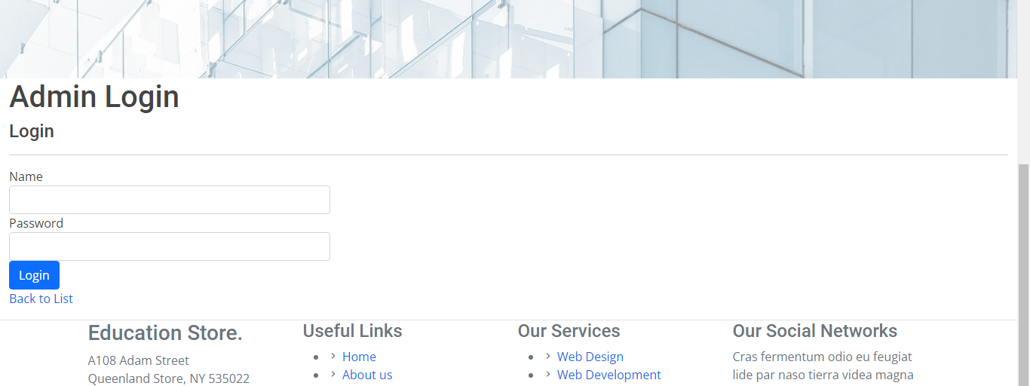
Login Page
Firstly We need to Login to access the Website

Slide 6
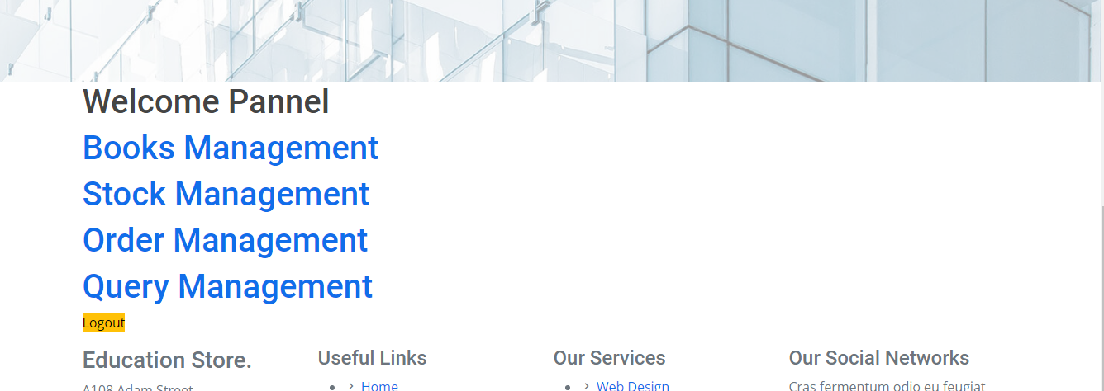
Admin Panel
After Logging in we will get this screen

Slide 7
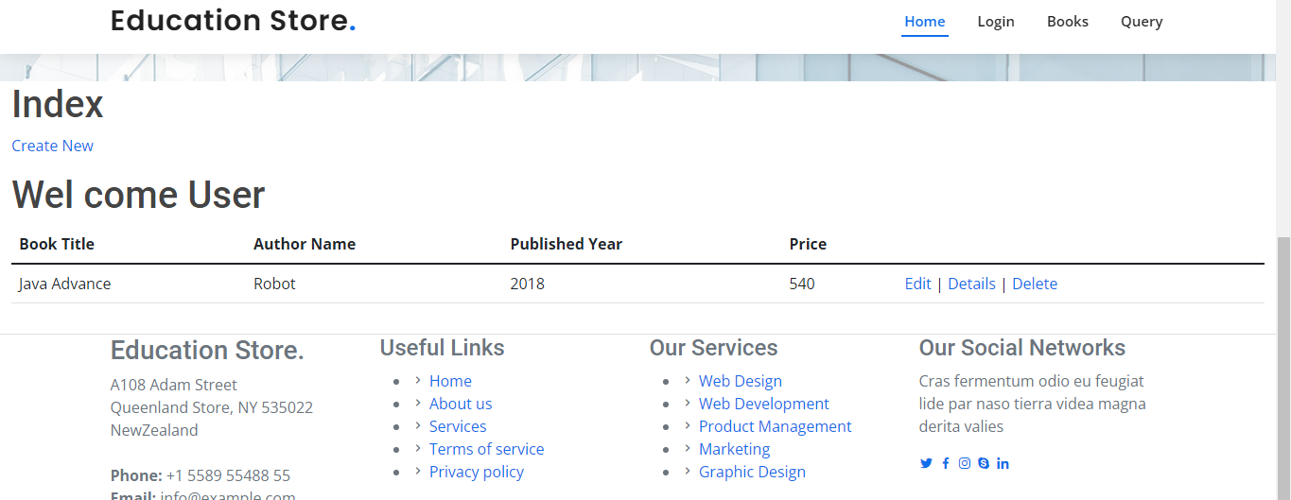
Books details can be entered that will be shown to index page

Slide 8
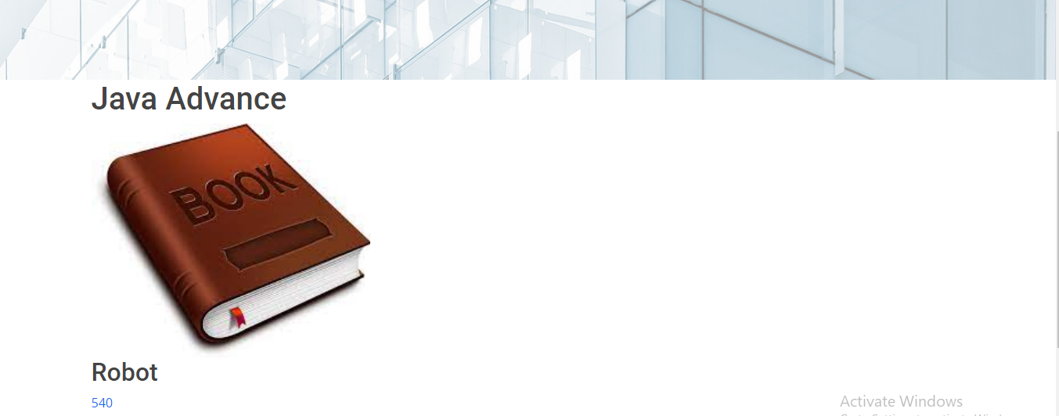
Books
Entered Books can viewed on Books Page

Slide 9
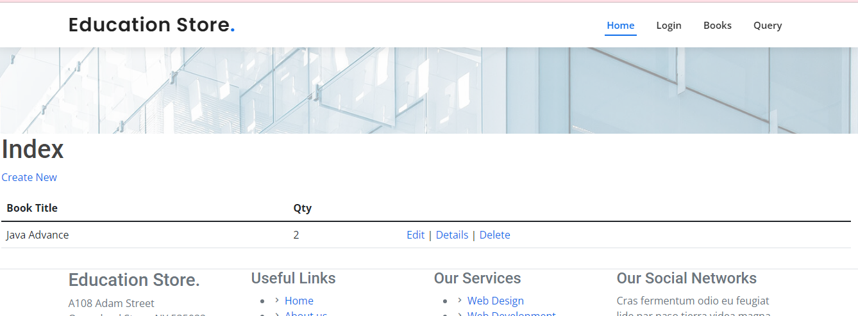
Stock Page

Slide 10
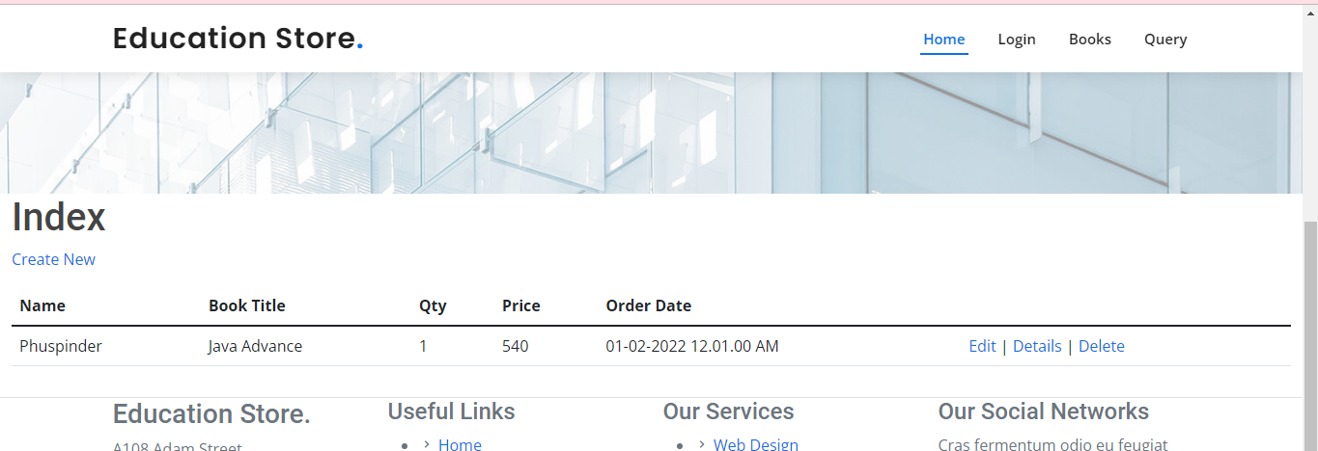
Order Page

Slide 11
Thank You

